Slide 1
IntelliJ4Life - CHAD P3
Ryan Williams, Chris Haynes, Colton Larson, Sandeep Chundru, Scott Swensen

Slide 2
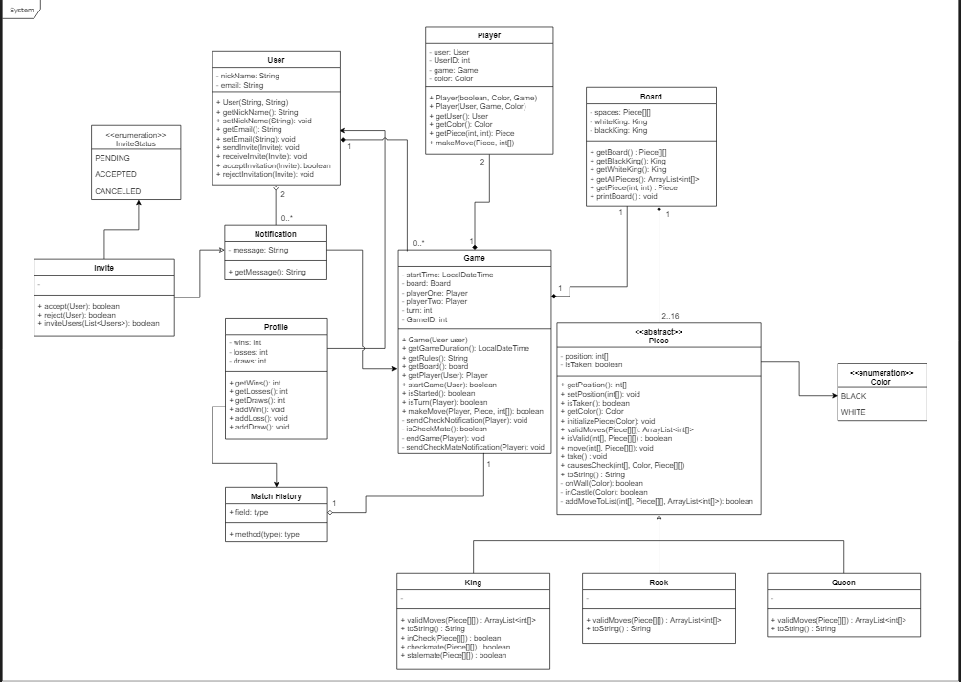

Slide 3
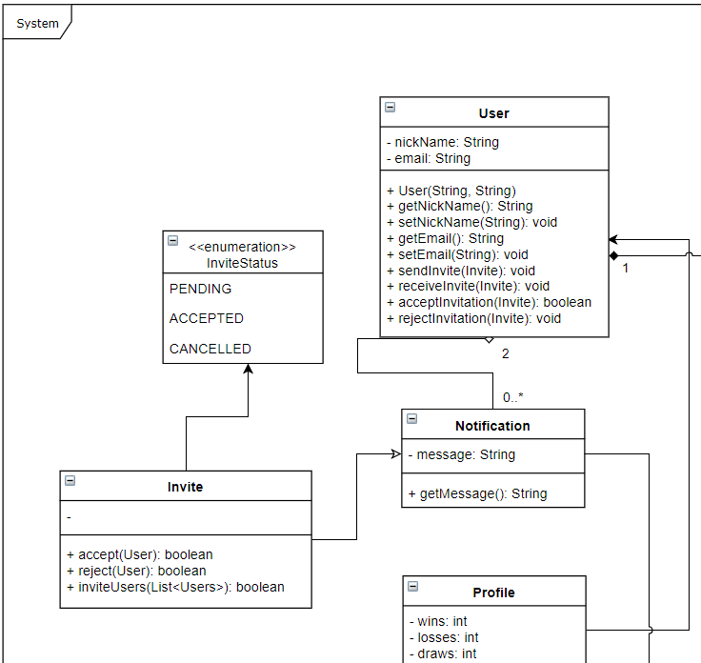
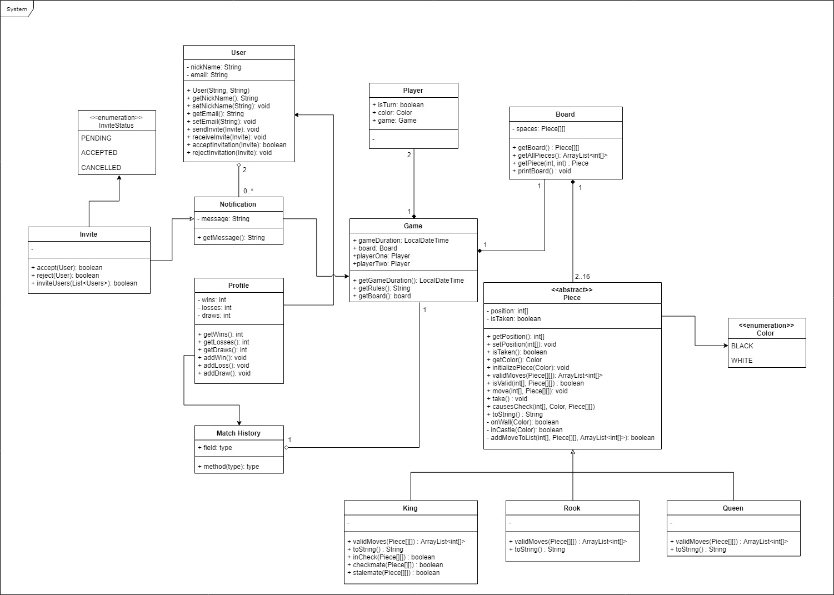
Class Diagram
Parts

Slide 4
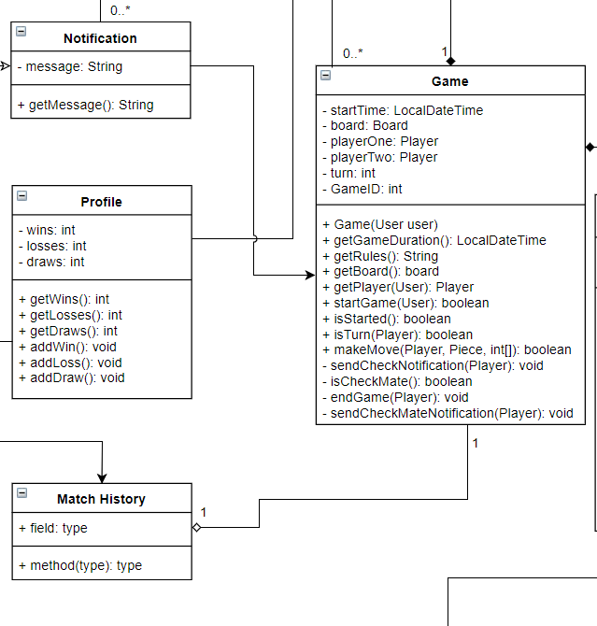
Class Diagram
Parts

Slide 5
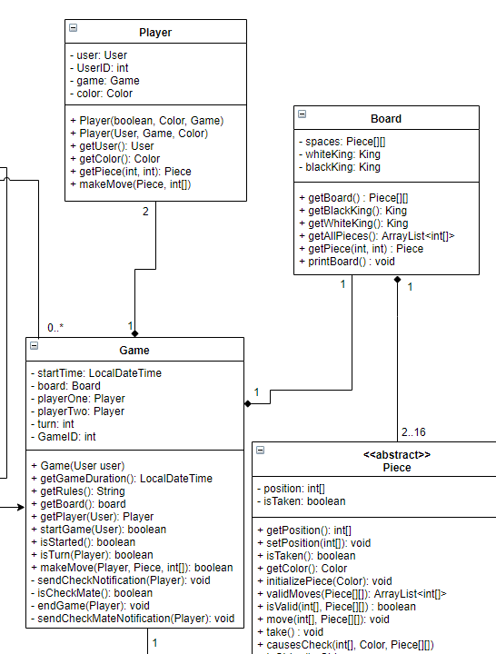
Class Diagram
Parts

Slide 6
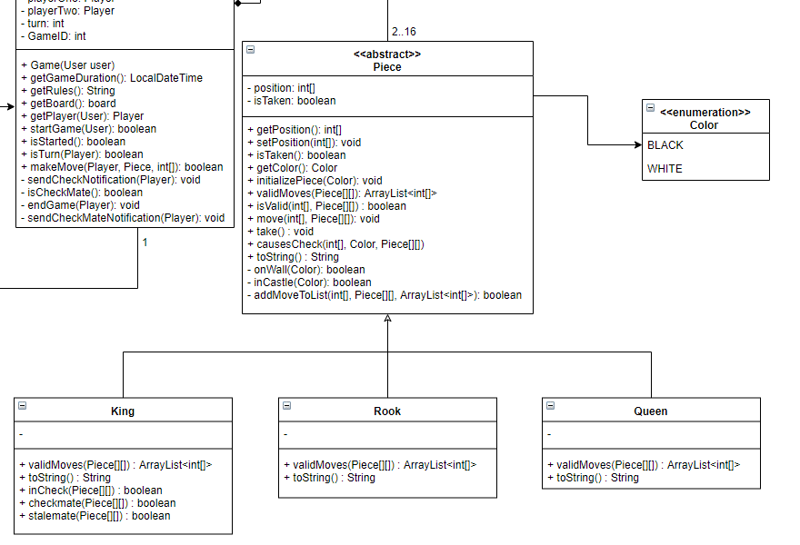
Class Diagram
Parts

Slide 7
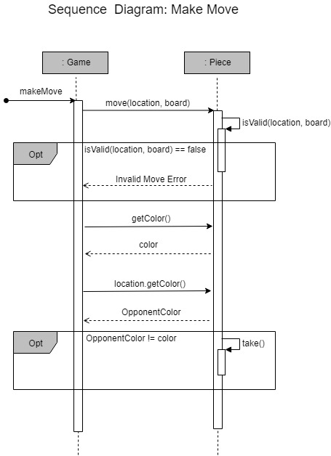
Sequence
Diagram:
Make Move

Slide 8
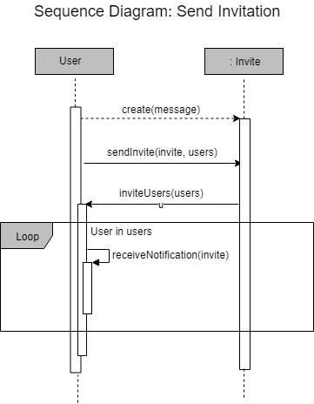
Sequence
Diagram:
Send Invitation

Slide 9
Demo

